Slide 1
Language Processor Computer Programming Btech CSE

Slide 2
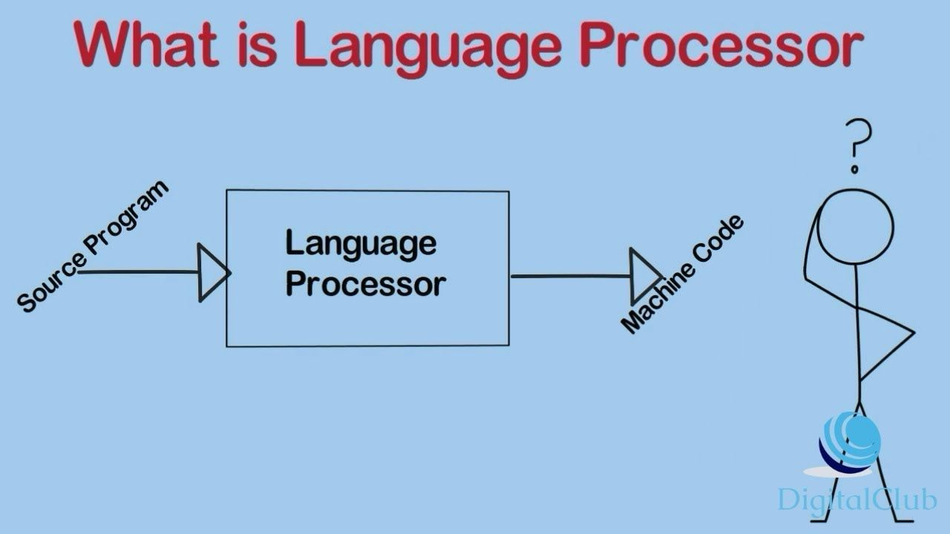

Slide 3

Language Processor
Language processor is a utility program that takes input as a source program and generate output as machine code.
Machine code is language consisting of binary and hexadecimal instructions that computer can respond directly.
executed directly by the CPU

Slide 4
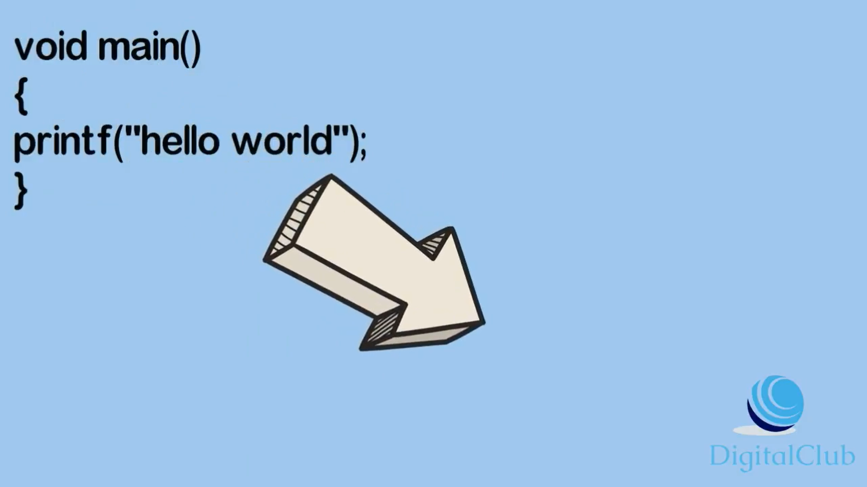

Slide 5
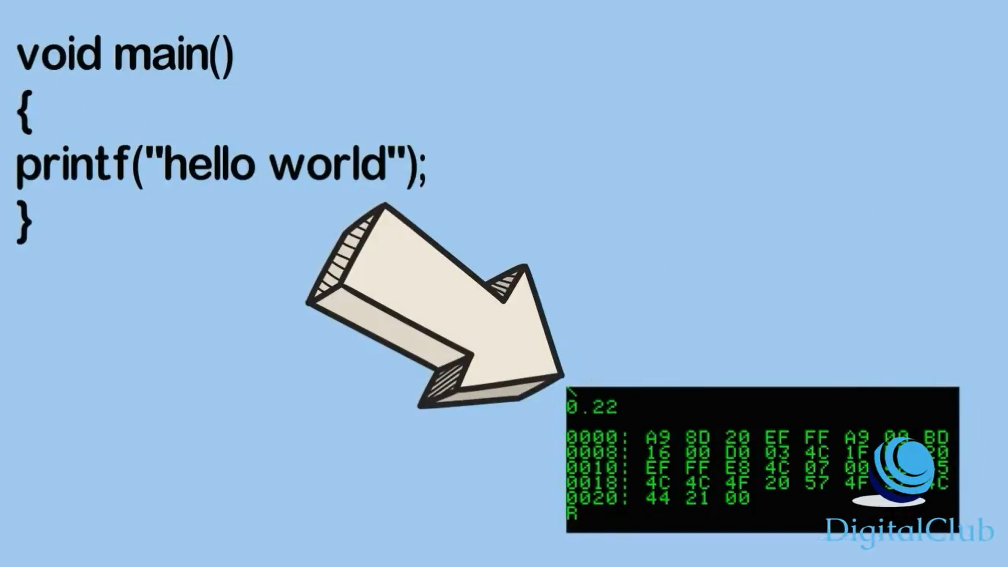

Slide 6
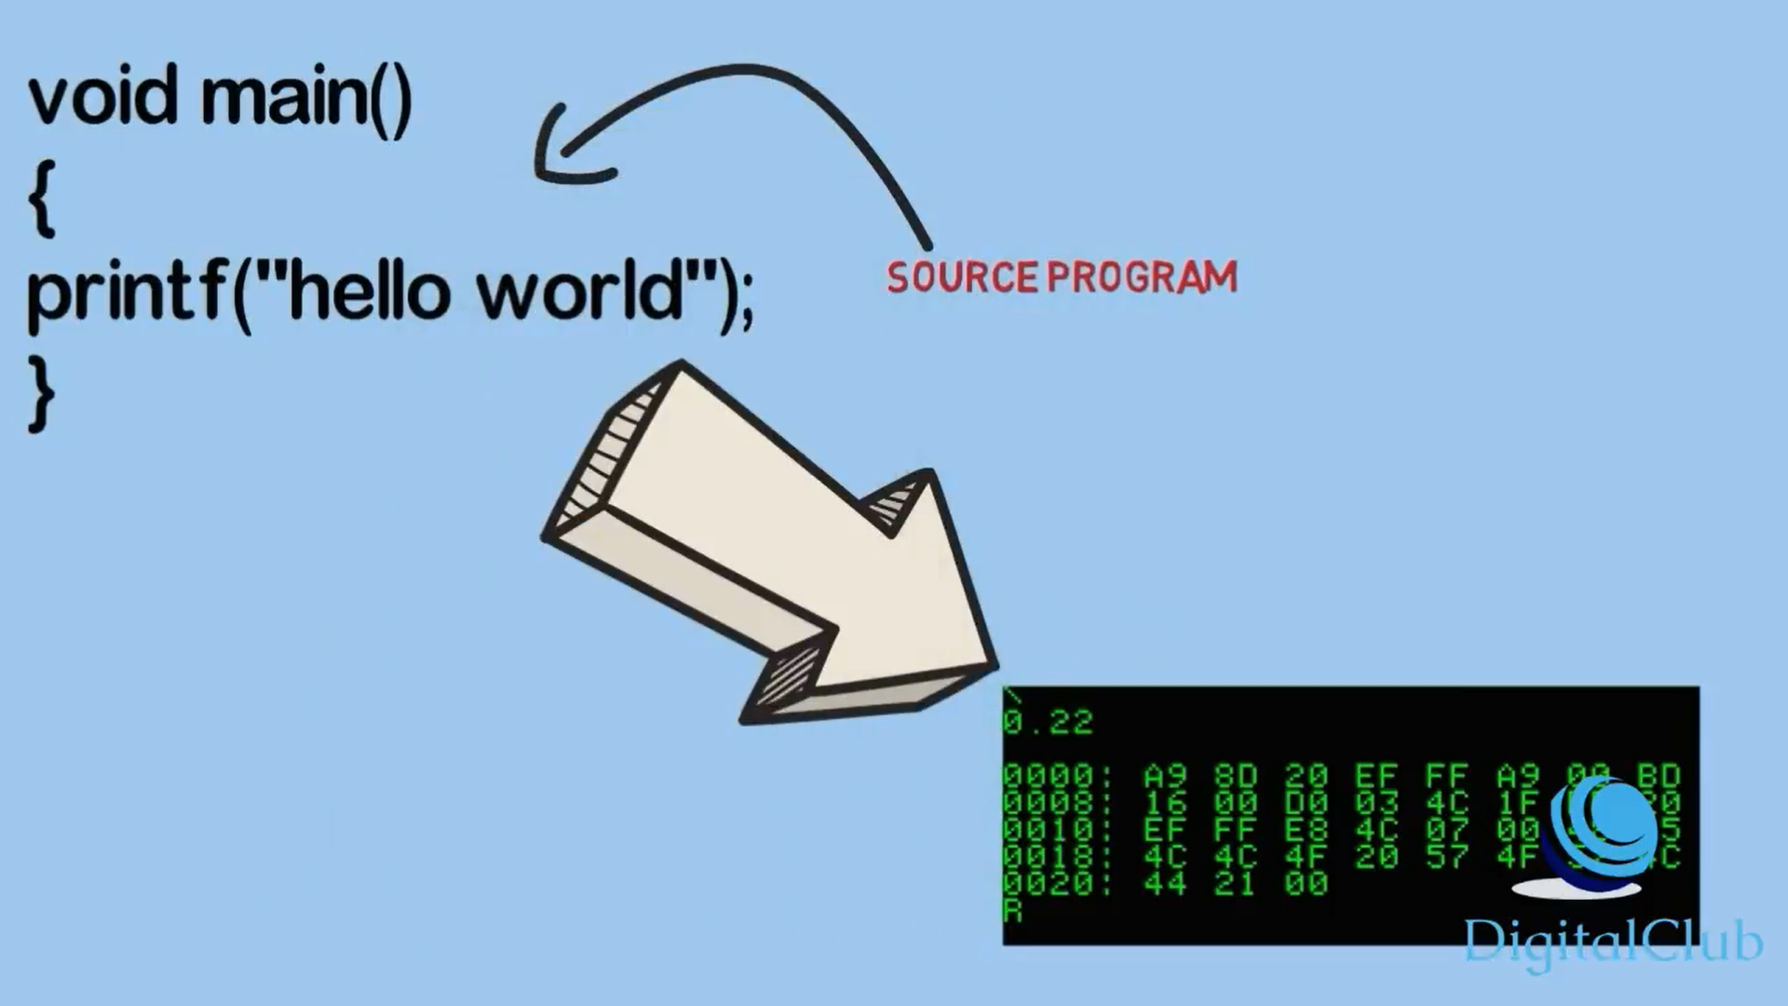

Slide 7
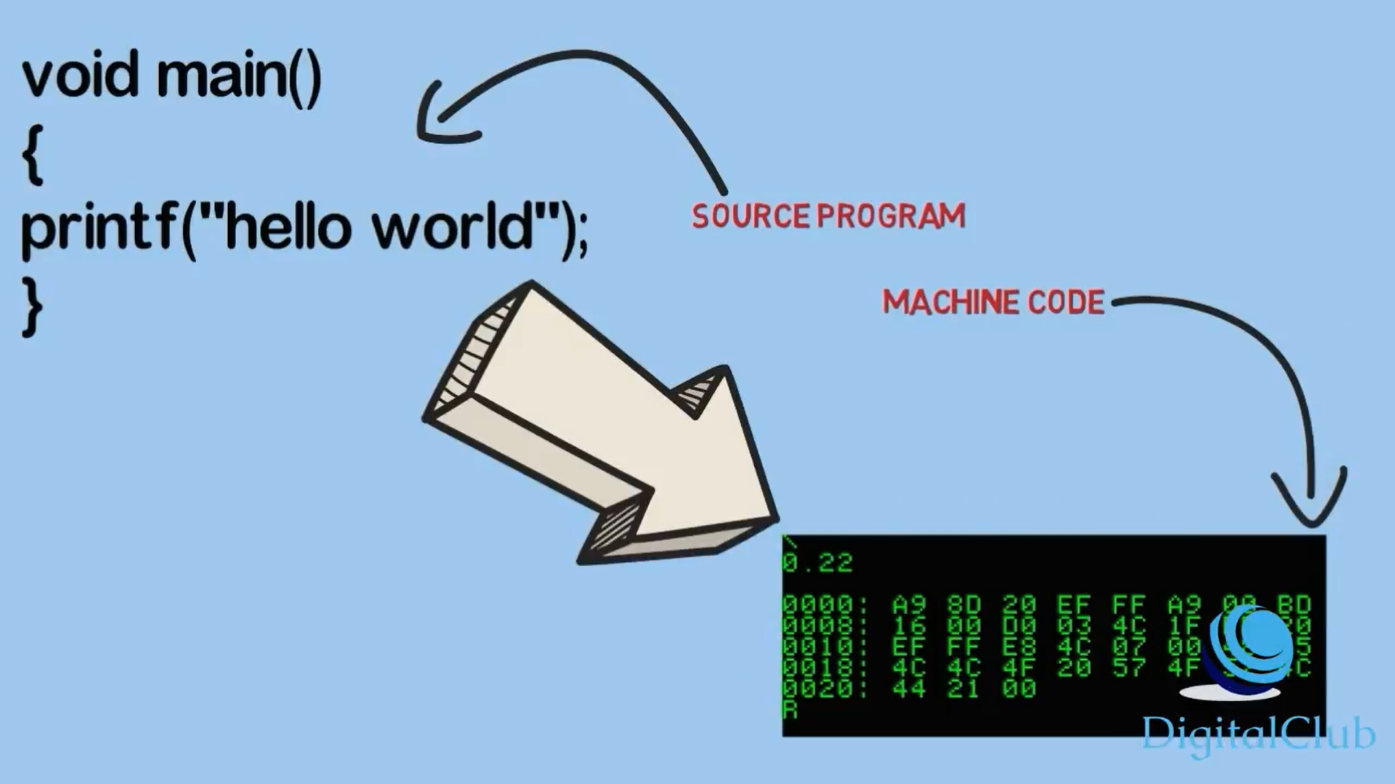

Slide 8
Language Processor kinds of language processor
Compiler
Interpreter
Assembler

Slide 9
Compiler
Compiler is used to translate an high level programming language code to machine level code and to create an executable program.
Compiler checks the error in the program and reports them. All errors are to be removed otherwise code will not be compiled and executed.

Slide 10
Interpreter
Interpreter is a program that translates high level language to machine code but one statement at a time unlike compiler who reads the whole program at once
Interpret one instruction at a time.

Slide 11
Assembler
Assembler is used to translate an assembly level code to machine readable code. Assembler too checks the correctness of each instruction and reports the diagnosis report.
Assembly language program
Machine language program
Assembler
input
output

Slide 12
Linker
Resolves the relative location of instructions and data
Links libraries with the object and put them together as executable.
Combine different-different object file into single executable file example .exe in window operating system
Lib
Obj
Obj
Linker
Lib
dll
exe

Slide 13


Loader
Inbuilt component of OS.
Loads program in to main memory and prepare them for execution

Slide 14
Review
User writes a program in C language (high-level language). The C compiler, compiles the program and translates it to assembly program (low-level language). An assembler then translates the assembly program into machine code (object). A linker tool is used to link all the parts of the program together for execution (executable machine code). A loader loads all of them into memory and then the program is executed.

Slide 15
Thank you

